Slide 1





ReDi2Service & In4Uptime
Sławomir Nowaczyk, Thorsteinn Rögnvaldsson, Stefan Byttner
Fredrik Bode, Niclas Karlsson, Rune Prytz

Slide 2
Predictive Maintenance
“Plannable” downtimes
  avoid high consequential costs for unplanned stops
Shorter workshop visits
  better planning and diagnostics
  reduce number of incorrect repairs
Optimization of maintenance intervals
  based on needs of individual vehicles
Increase knowledge about vehicles and their usage

Slide 3
Business Model Change
“In future, all companies will be software companies”
  George Colony, CEO of Forrester Research
Automotive industry is moving products to services
  but this will require fundamental shift in business models
In particular, there is a need to improve things quickly
  software as the medium allows much faster innovation cycles
A development cycle has to be based on actual data
  following “Build – Measure – Learn” model

Slide 4
The Uptime Problem
Vehicles are becoming more and more complex
  we need better diagnostic and fault detection systems
Building specialised diagnostic functions is expensive
  it is unrealistic to expect that for each individual fault
Real usage data shows actual problems to look for
  sometimes what is “known” turns out to be wrong
What is important to focus on changes with age
  we need continuous monitoring and life-long learning

Slide 5
Two Approaches
Classical supervised machine learning
  research problems arise from the specifics of the data
Self-organising, unsupervised knowledge discovery
  create a system that can “understand” its own operation
Interesting
Faults
Vehicle
Data
Predictive
Maintenance
Vehicle
Data
Explaining
Deviations
Predictive
Maintenance

Slide 6
Self-Monitoring System
We have a “sniffer” on-board every vehicle
  it learns the data characteristics (model) of that vehicle
Those models are then compared between vehicles
  discovering what is normal/abnormal for a particular fleet
Detected deviations are then matched against repairs
  to find out which faults (if any) can be responsible
The goal is to increase vehicle uptime
  a self-monitoring system should, with time, become an “expert” that can highlight interesting patterns in the data

Slide 7
Targeted Diagnostics
Data based on Alen Atamer (2004) Comparison of FMEA and Field-Experience for a Turbofan Engine with Application to Case-Based Reasoning, IEEE Aerospace Conference.
FMEA
anticipated
failure modes
(610 examples)
Faults
encountered
in the field
(727 examples)
23% overlap (142 examples)

Slide 8
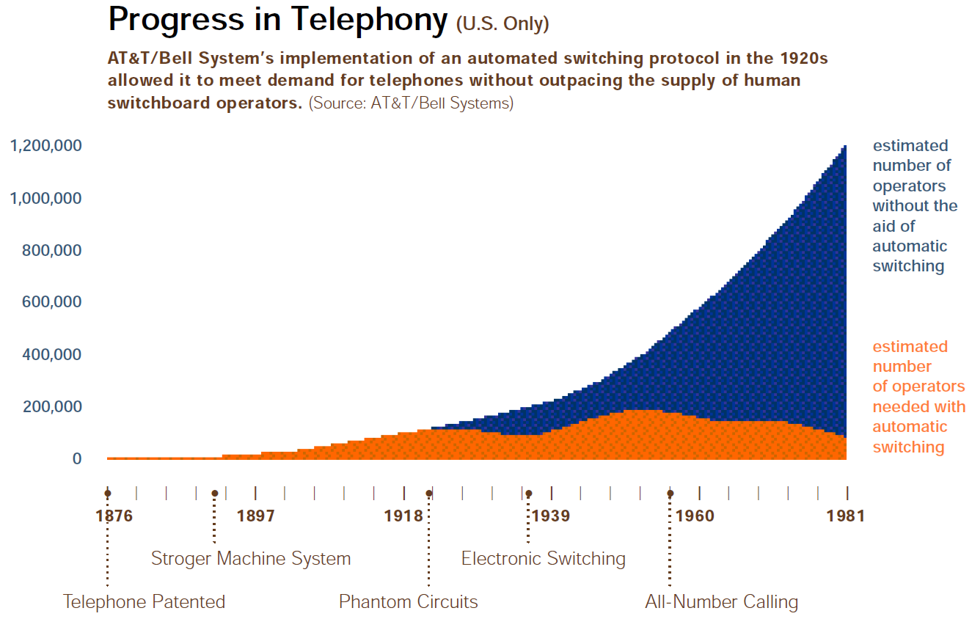
The Leap

Slide 9
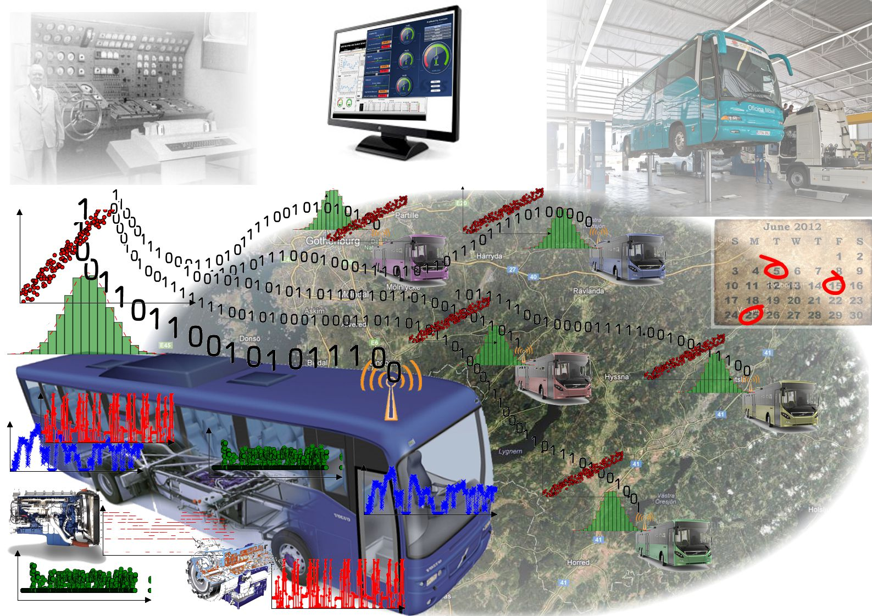

Slide 10
Learning Fleet
System automatically finds signals to analyse
  from on-board data and fault information
System defines what is normal and what is not
  warns about detected deviations and irregularities
  identifies possible faults by linking against service records
Learns characteristics of faults that actually happen
  can present and explain them to workshop personnel
It is not as reliable nor accurate as focused diagnostic
  it is designed to support, not replace, experts

Slide 11
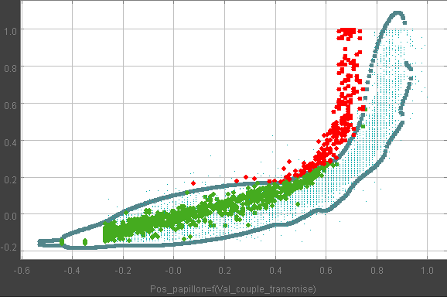
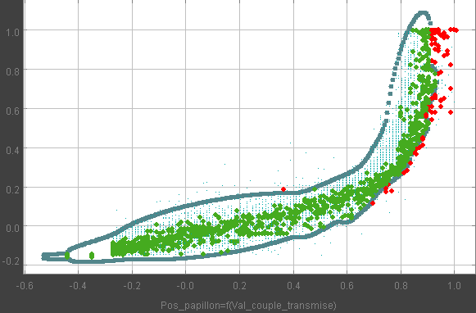
Classical Approach
Air admission blocked
Injector blocked
Expert defines what to look at and what is normal
  identifies factors relevant for each possible fault
This approach works very well and is reliable
  but does not scale sufficiently well

Slide 12
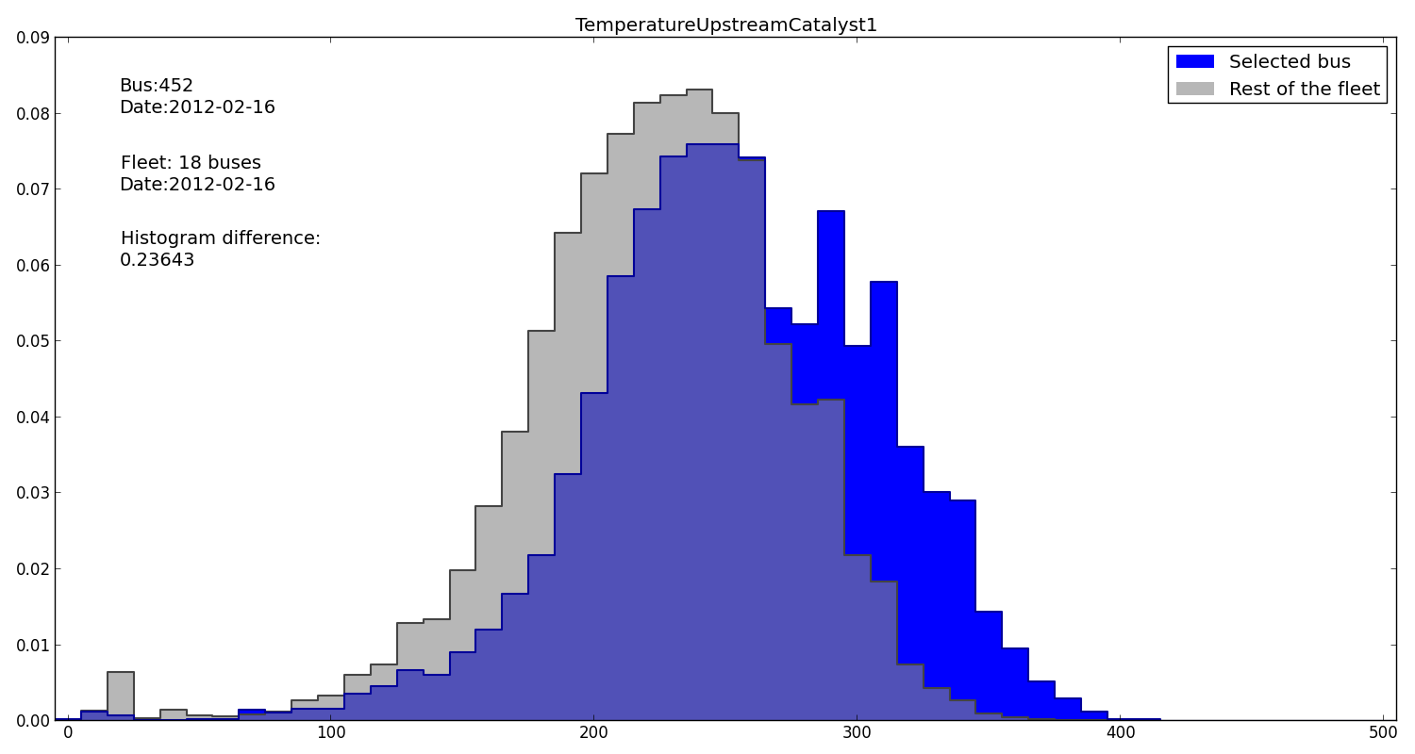
Fleet-based Approach

Slide 13
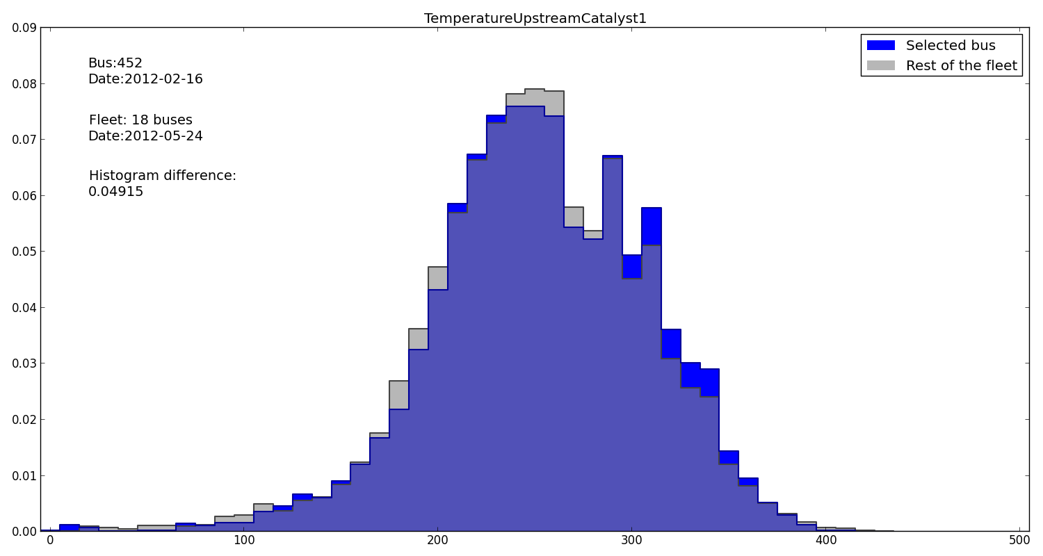
Fleet-based Approach

Slide 14
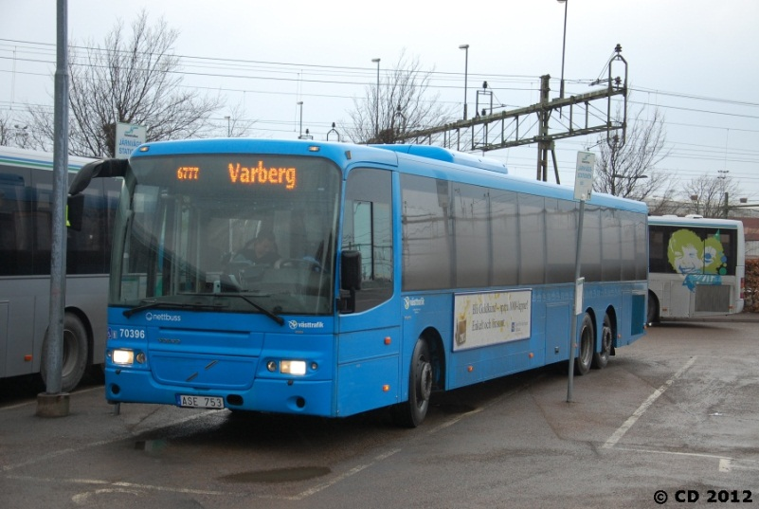
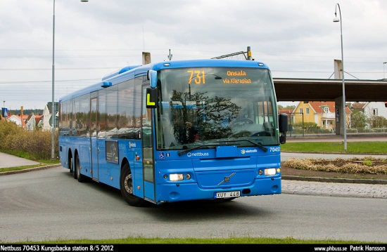
Long-term pilot study
Over 3 years (since fall 2011)
19 Volvo buses (8500 model)
  14 from year 2007
  5 from year 2008/2009
  driven about 100,000 km/year each
In service around Kungsbacka
  rotating routes and drivers
We are logging ~100 signals
  at 1 Hz frequency
  around 500MB/week/bus of data`

Slide 15
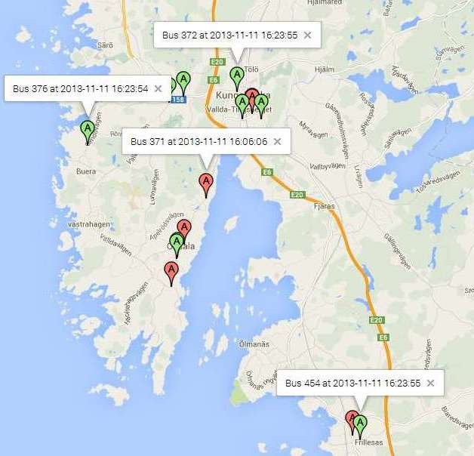
The VACT system
(Volvo Analysis and Communication Tool)
DynaFleet hardware
  software developed in
  the ReDi2Service project
Communication
  GPS, GPRS modem
  3 CAN interfaces
  USB memory
Easy to configure onboard logging capabilities
  as well as on-line data analysis functions

Slide 16
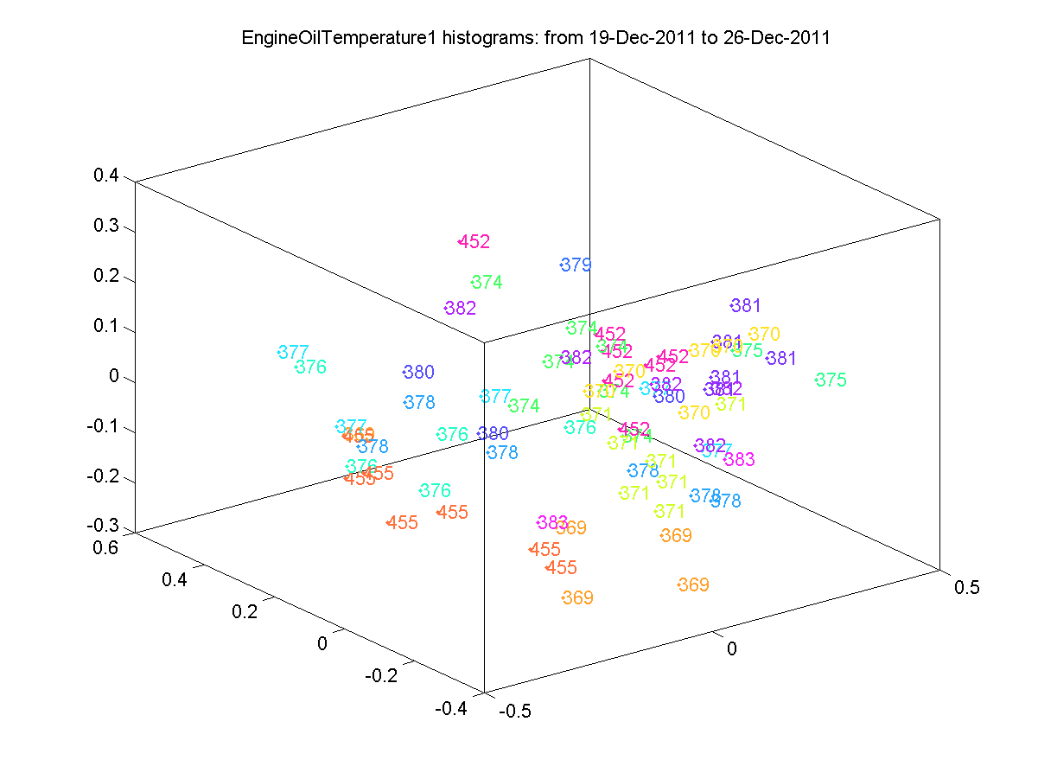
Fleet Histograms
Distances between histograms
  of Engine Oil Temperature
  19 different vehicles
  during one week in 2011
Each point corresponds to a bus observation
(illustrated using multidimensional scaling)
Histograms are evenly distributed:
nothing strange

Slide 17
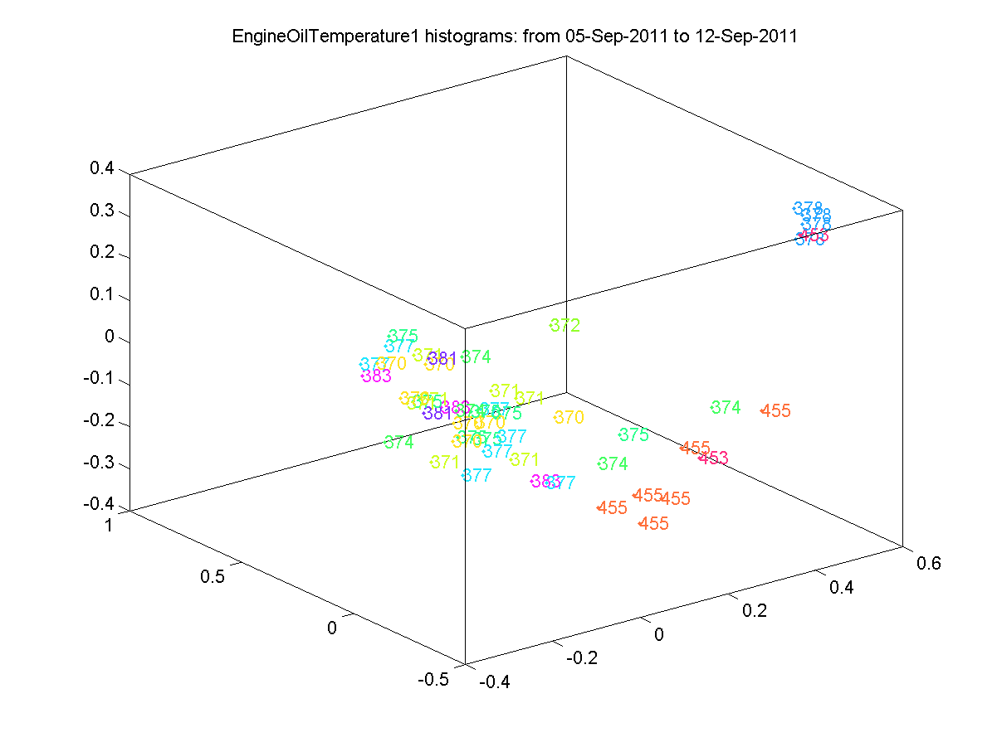
Fleet Histograms
We are looking for a vehicle that is different from rest of the group
By analysing the VSR: consistent deviation of bus 378 is caused by a broken ECU...
Cooling fan runs at full speed all the time

Slide 18
Bus 70452
2009 model

Slide 19
Bus 70452
2009 model
Complaints that engine „runs strangely”
Probable cause:
CAC leak
(Apr 12)
Coolant system
leak (Dec 5)
Tampering with EBS
system (”sabotage”)
Volvo Action Service
(Feb 10)
Problems with
alternator belt
tension
(Jul 30)
Sep
Jan
Jul
Jan
2011
2012
2013
Oil pressure
problems
(Mar 2)
Service
(Oct 8)
Gear box
problems
(Nov 28)
Problems with
Strocco heater
(Dec 9 & Jan 30)
Service before
annual inspection
(inspection
Apr 24)
Engine ”knocks”.
Cylinder 1 jams
during annual
inspection.
(Repair May 4)
Gear box not
working, replaced
or repaired
(Nov 26)

Slide 20
Bus 70452 – The Data
Temperature Upstream Catalyst is higher for a long period of time, and keeps growing

Slide 21
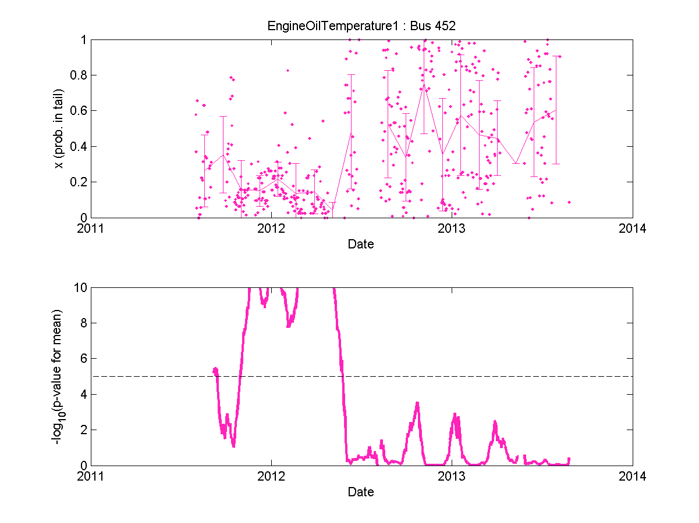
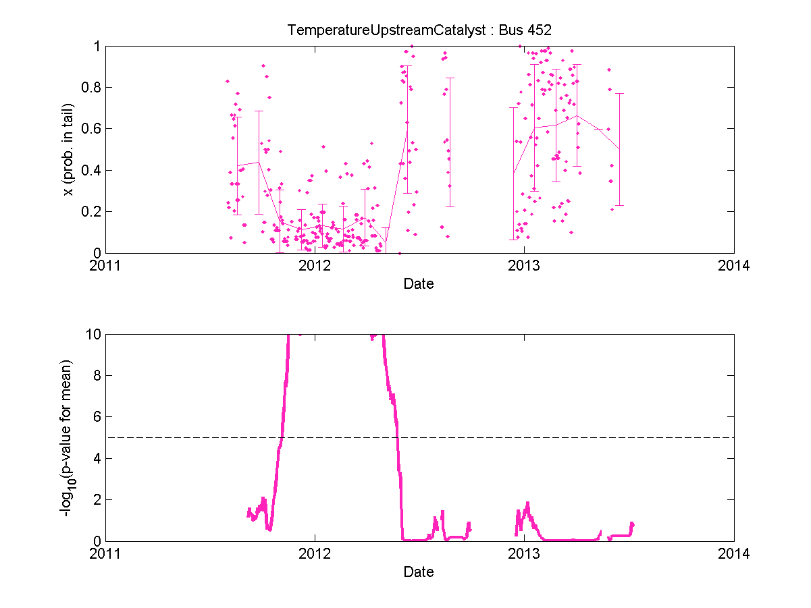
Those two temperatures both show significantly abnormal characteristics since November 2011
Both those deviations
disappear in May 2012
Notes:
Combine 28 and 29

Slide 22
Bus 70452
2009 model
Complaints that engine „runs strangely”
Probable cause:
CAC leak
(Apr 12)
Coolant system
leak (Dec 5)
Tampering with EBS
system (”sabotage”)
Volvo Action Service
(Feb 10)
Problems with
alternator belt
tension
(Jul 30)
Sep
Jan
Jul
Jan
2011
2012
2013
Oil pressure
problems
(Mar 2)
Service
(Oct 8)
Gear box
problems
(Nov 28)
Problems with
Strocco heater
(Dec 9 & Jan 30)
Service before
annual inspection
(inspection
Apr 24)
Engine ”knocks”.
Cylinder 1 jams
during annual
inspection.
(Repair May 4)
Gear box not
working, replaced
or repaired
(Nov 26)

Slide 23
Bus 70452
The CAC repair April 12, 2012, is probably an erroneous repair
The CAC was not the problem
Complaints that engine „runs strangely”
Probable cause:
CAC leak
(Apr 12)
Coolant system
leak (Dec 5)
Tampering with EBS
system (”sabotage”)
Volvo Action Service
(Feb 10)
Problems with
alternator belt
tension
(Jul 30)
Sep
Jan
Jul
Jan
2011
2012
2013
Oil pressure
problems
(Mar 2)
Service
(Oct 8)
Gear box
problems
(Nov 28)
Problems with
Strocco heater
(Dec 9 & Jan 30)
Service before
annual inspection
(inspection
Apr 24)
Engine ”knocks”.
Cylinder 1 jams
during annual
inspection.
(Repair May 4)
Gear box not
working, replaced
or repaired
(Nov 26)

Slide 24
Bus 70452
The bus was unavailable to the operator for
one month, undergoing full engine renovation… Immediately after a one week-long service visit!
Complaints that engine „runs strangely”
Probable cause:
CAC leak
(Apr 12)
Coolant system
leak (Dec 5)
Tampering with EBS
system (”sabotage”)
Volvo Action Service
(Feb 10)
Problems with
alternator belt
tension
(Jul 30)
Sep
Jan
Jul
Jan
2011
2012
2013
Oil pressure
problems
(Mar 2)
Service
(Oct 8)
Gear box
problems
(Nov 28)
Problems with
Strocco heater
(Dec 9 & Jan 30)
Service before
annual inspection
(inspection
Apr 24)
Engine ”knocks”.
Cylinder 1 jams
during annual
inspection.
(Repair May 4)
Gear box not
working, replaced
or repaired
(Nov 26)

Slide 25
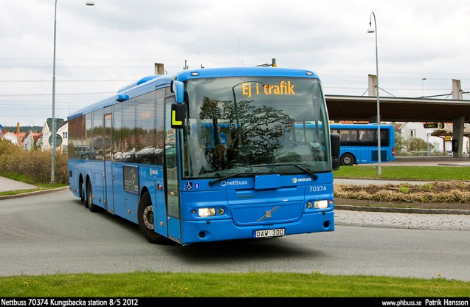
Bus 70378
2007 model

Slide 26
Bus 70378
2007 model
Broken
piston rod
in gear box
(Sep 26)
Clutch problem
(Oct 21)
Oil leak
and broken
oil level
sensor
(Dec 23)
Water leak
in cooling
system
(Jun 7)
Gear box
renovation
(Nov 7)
Broken
modulator
(May 23)
Press guard
AC broken
(Sept 19)
Coolant
leak
(Nov 28)
Press guard
AC broken
(Jul 7
Coolant
leak
(Feb 27)
Sep
Jan
Jul
Jan
2011
2012
2013
Stroco heater
problems
(Jan 18)
Low oil level in
gear box
(Sep 16)
Broken ECU
(oil leak)
and problem
with urea
dosing
(Oct 24)
Leak by
compressor
Volvo
Action
Service
(May 27)
Problem
with
Stroco heater
(12 Dec,
14 Feb)
Broken fuel
pump
(Sept 21)
Service before
annual
inspection
(inspection
Apr 17)
Service, new
NOx sensor
(Oct 10)

Slide 27
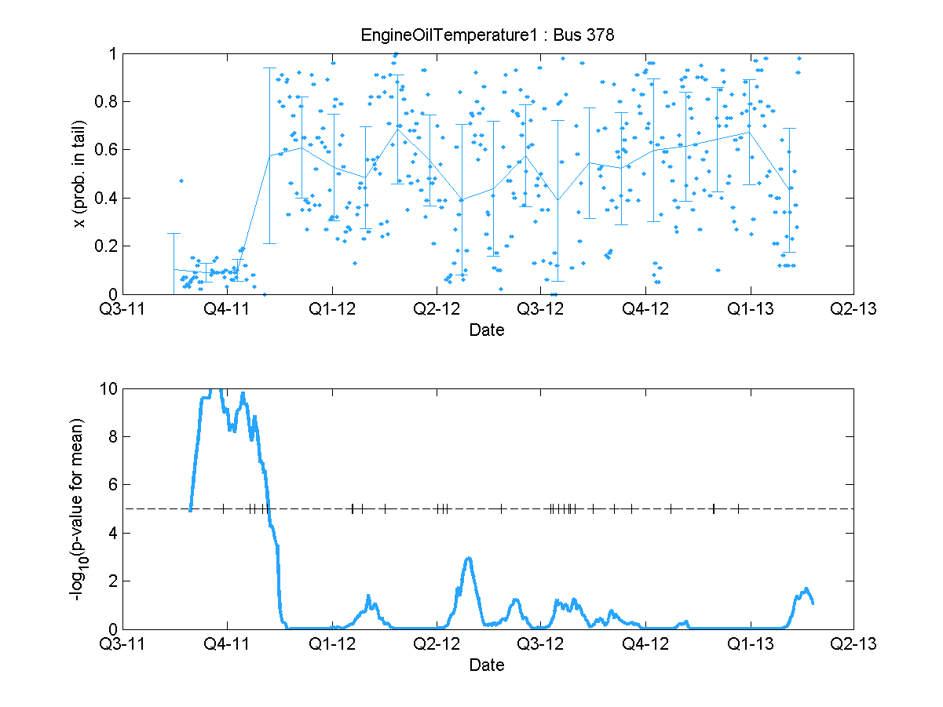
Bus 70378 – The Data

Slide 28
Bus 70378
2007 model
Broken
piston rod
in gear box
(Sep 26)
Clutch problem
(Oct 21)
Oil leak
and broken
oil level
sensor
(Dec 23)
Water leak
in cooling
system
(Jun 7)
Gear box
renovation
(Nov 7)
Broken
modulator
(May 23)
Press guard
AC broken
(Sept 19)
Coolant
leak
(Nov 28)
Press guard
AC broken
(Jul 7
Coolant
leak
(Feb 27)
Sep
Jan
Jul
Jan
2011
2012
2013
Stroco heater
problems
(Jan 18)
Low oil level in
gear box
(Sep 16)
Broken ECU
(oil leak)
and problem
with urea
dosing
(Oct 24)
Leak by
compressor
Volvo
Action
Service
(May 27)
Problem
with
Stroco heater
(12 Dec,
14 Feb)
Broken fuel
pump
(Sept 21)
Service before
annual
inspection
(inspection
Apr 17)
Service, new
NOx sensor
(Oct 10)

Slide 29
Bus 70378 – The Data
The ECU was replaced on October 24
Oil leaked into the contact so that the circuit was shorted
This caused cooling fan to be running at full speed all the time

Slide 30
Kungsbacka Results
Multiple different problems have been detected
  cylinder jam
  ECU fault resulting in cooling fan overuse
  NOx sensors
  wheel speed sensors
  wheel speed sensor modulators
But we have had limited success with compressor
  one of the reasons being not enough relevant data
  we only have access to Wet Tank Air Pressure signal

Slide 31
Summary
Self-monitoring can reduce number of unplanned stops
  multiple serious faults have been detected early
  cylinder jams, ECU faults, NOx and wheel speed sensors
  but we have had limited success with air compressor
ReDi2Service is a generic and adaptive approach
  not directed at specific faults, making use of all available data
  develops with the life-time of the fleet, finding relevant faults
Cost efficient especially for rare and non-critical faults
  e.g. overuse of cooling fan causes fuel to be wasted
Increase overall knowledge about vehicles

Slide 32
Summary
This requires flexible data logging and processing
  interesting individual models are found on-board
    histograms, linear relations, neural networks, …
  comparison across the fleet is done off-board
    central server or peer-to-peer architecture
What is interesting to monitor changes in time
  a single compressor replacement between 2007 and 2012
  16 compressor replacements in 2013 and 2014
Important aspect is defining the fleet to compare against
  trade-off between size (confidence) and similarity (precision)

