Slide 1
Automatic Grammar Repair
Moeketsi Raselimo and Bernd Fischer
Stellenbosch University
South Africa

Slide 2
Grammars are software. Software contains bugs.
1

Slide 3
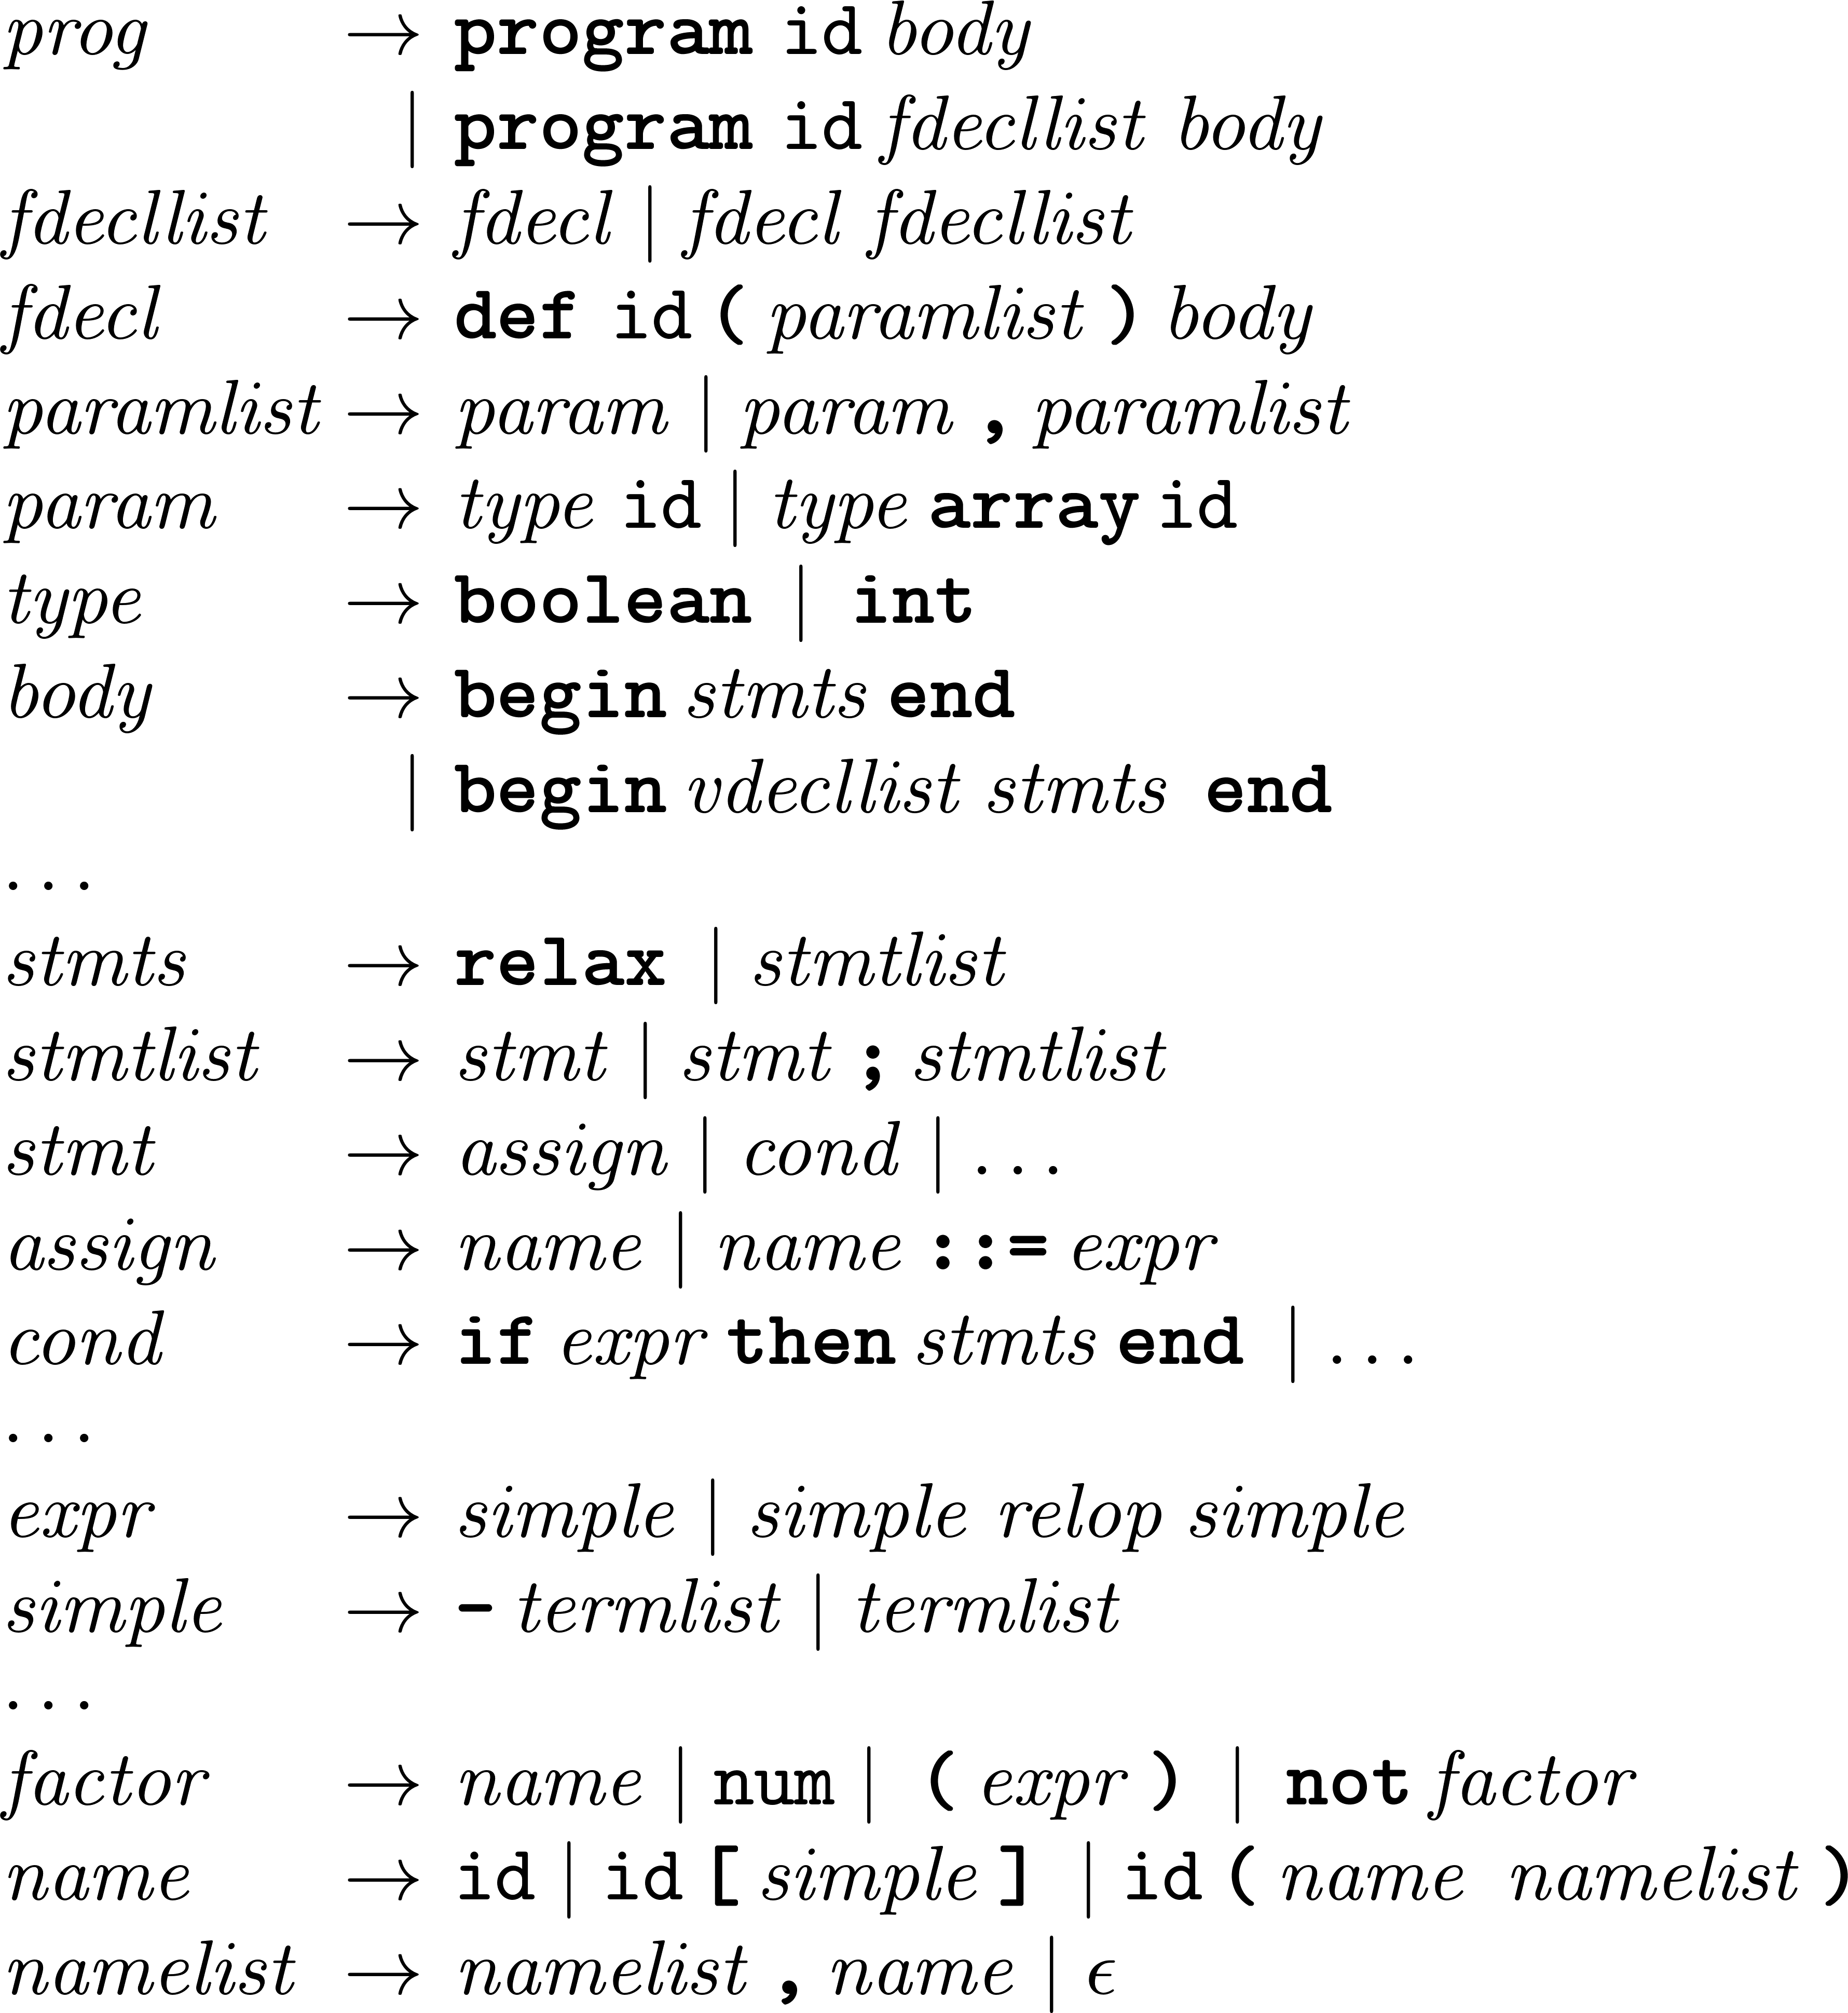
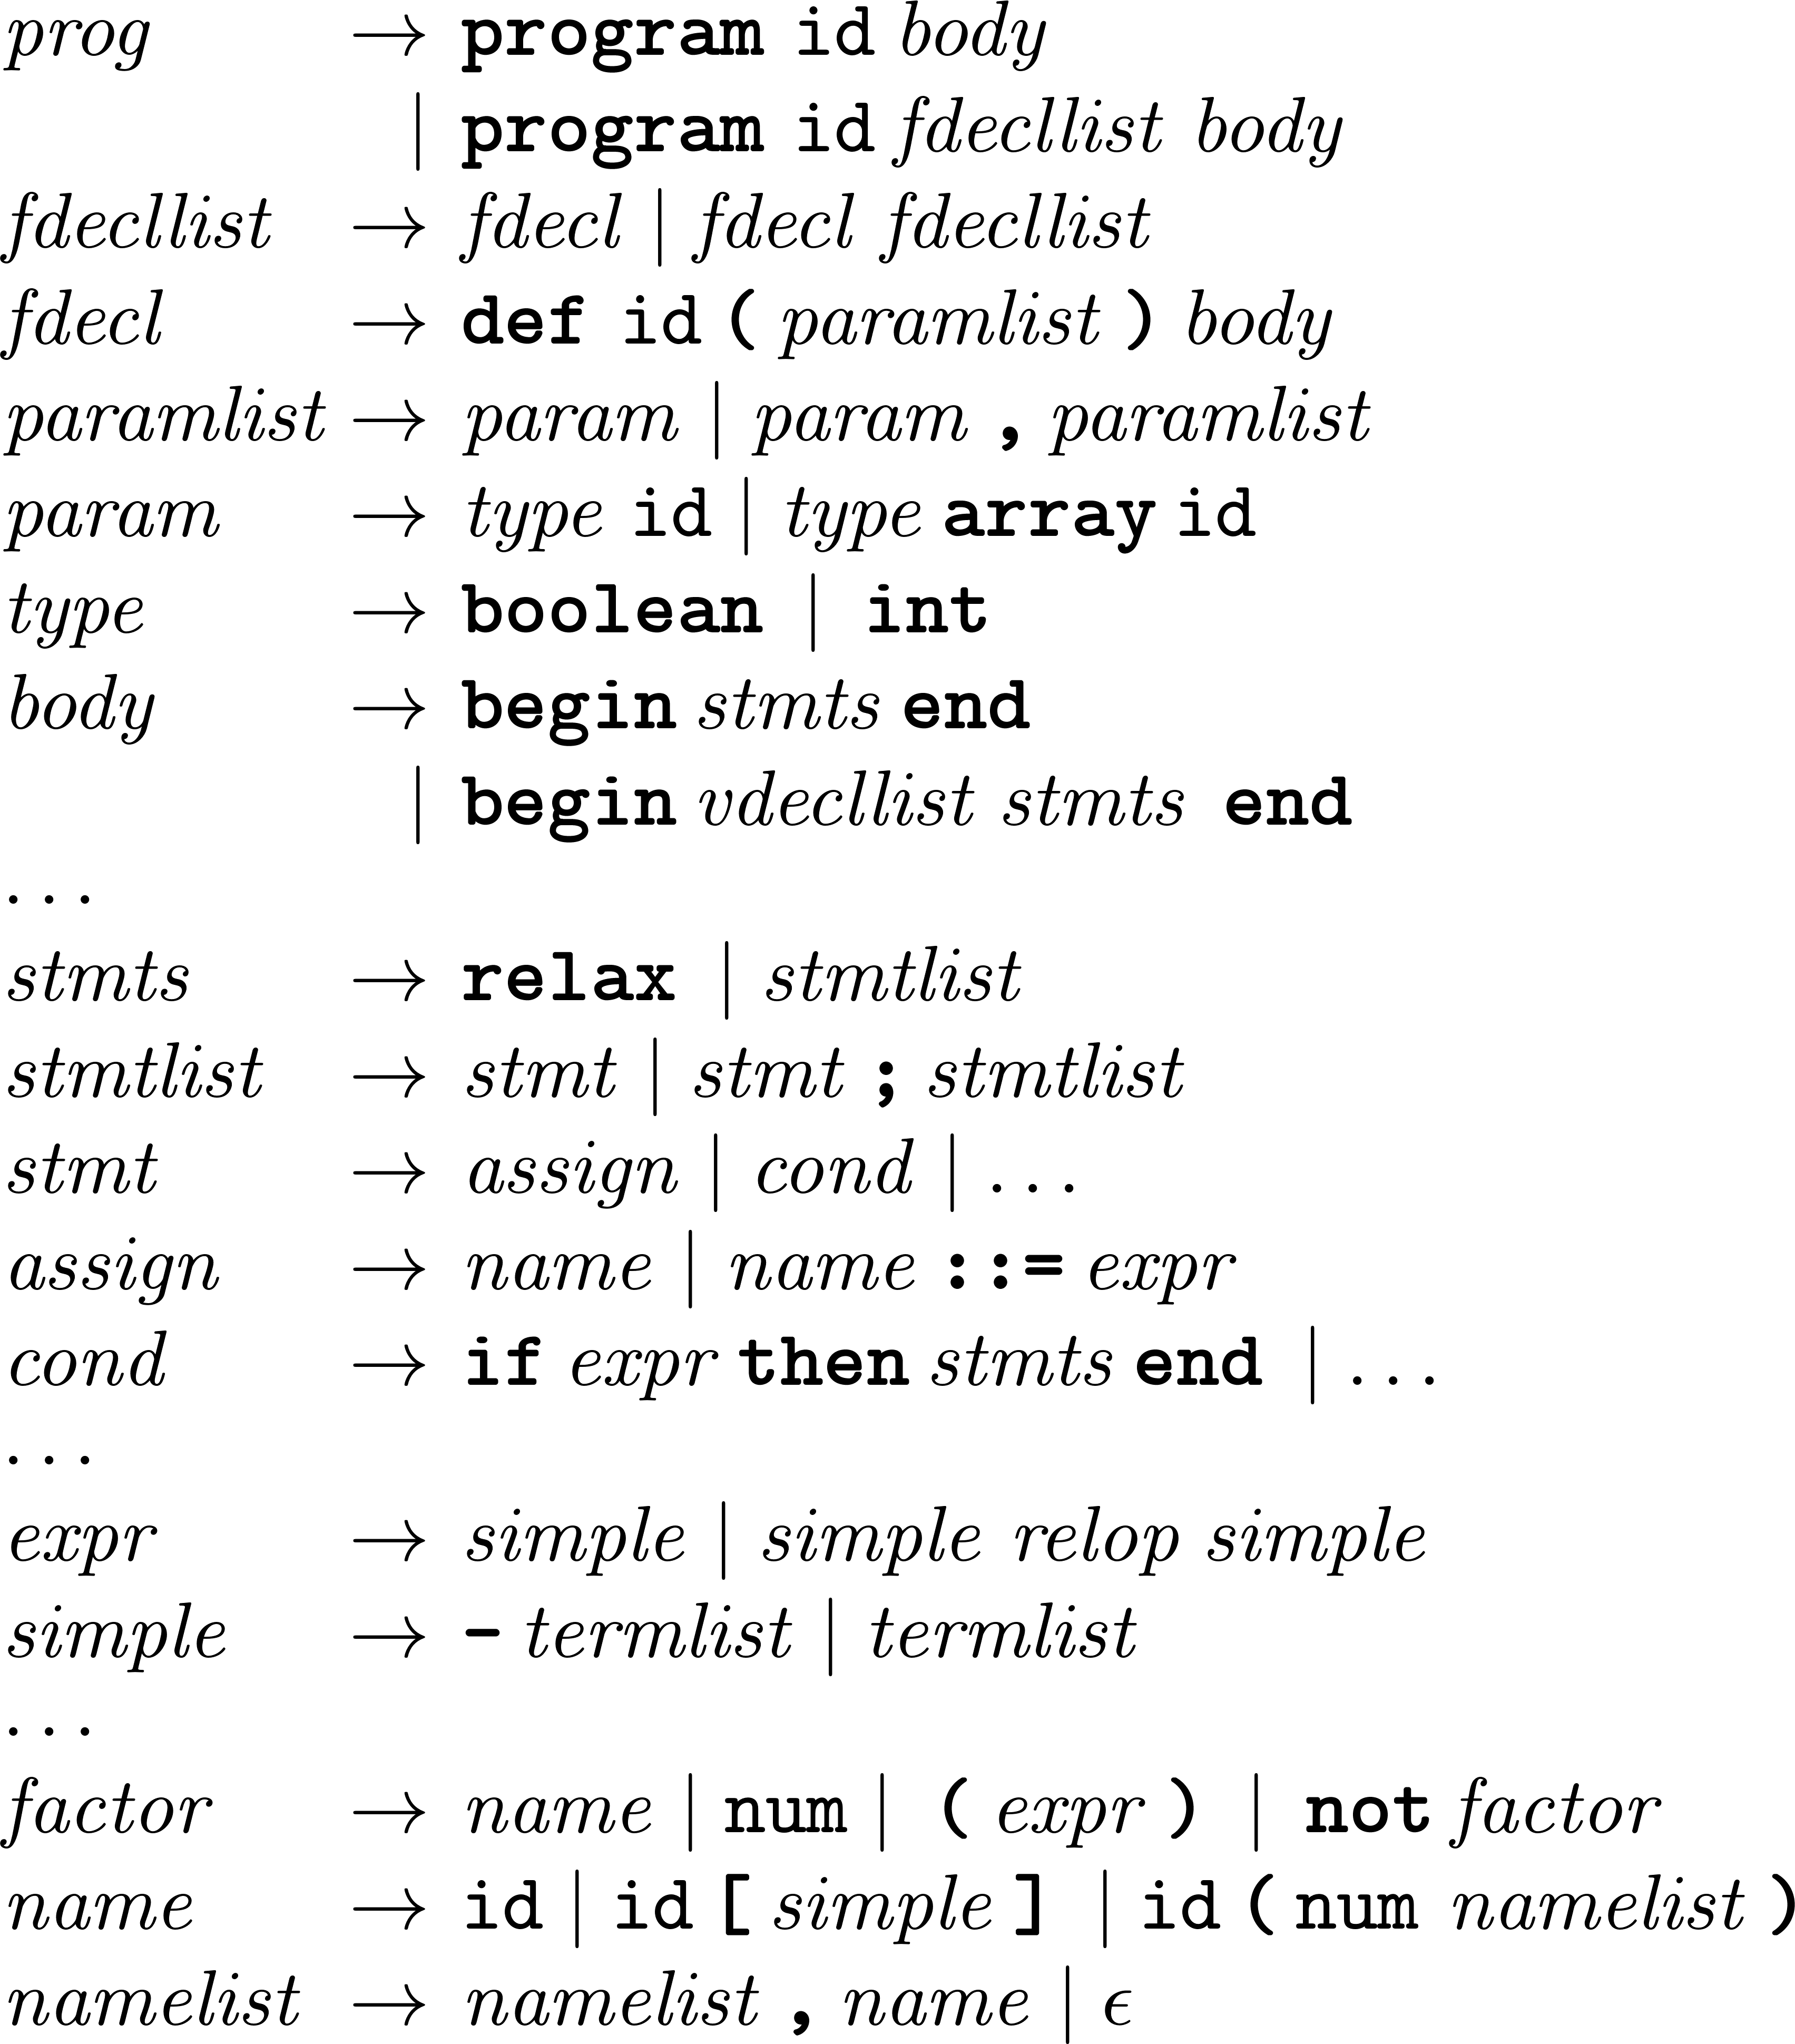


Grammars are software. Software contains bugs.
But how do you find and fix grammar bugs?
Manual test-driven find-and-fix loop (grammar debugging)
✗
program a begin relax end
program a begin a ::= 0 end
...
program a begin a(0) end
program a begin a(0,0) end
...
program a begin a(0) end
program a begin a(0,0) end
Error in line 1, column 19: Syntax error.
Found NUM(0), expected token classes are [].
1
Notes:
This manual process typically follows a manual find-and fix cycle
Assume we have a grammar that we generate a parser for
Assume we have tests that we can feed to the parser
Some tests fails, here we have these two. And the parser confirms the line no. and col for these two and provides not further useful info.
The parse fails after these opening parenthesis
And of course, the parser assumes the grammar is correct and the i/p is wrong, which isn’t the case here
After the substitution, we regenerate the parser and run the same tests
And we get the following failing test with a similar faults as before but a different location
We also find the same fault as before at a different rule that we fix similarly

Slide 4
Grammars are software. Software contains bugs.
But how do you find and fix grammar bugs?
Manual test-driven find-and-fix loop (grammar debugging)
✗
✗
program a begin relax end
program a begin a ::= 0 end
...
program a begin a(0) end
program a begin a(0,0) end
...
program a begin a(0) end
program a begin a(0,0) end
program a begin relax end
program a begin a ::= 0 end
...
program a begin a(0) end
program a begin a(0,0) end
...
program a begin a(0,0) end
Error in line 1, column 19: Syntax error.
Found NUM(0), expected token classes are [].
Error in line 1, column 21: Syntax error.
Found NUM(0), expected token classes are [].
2

Slide 5

Grammars are software. Software contains bugs.
But how do you find and fix grammar bugs?
Manual test-driven find-and-fix loop (grammar debugging)
✗
✗
program a begin relax end
program a begin a ::= 0 end
...
program a begin a(0) end
program a begin a(0,0) end
...
program a begin a(0) end
program a begin a(0,0) end
program a begin relax end
program a begin a ::= 0 end
...
program a begin a(0) end
program a begin a(0,0) end
...
program a begin a(0,0) end
Error in line 1, column 19: Syntax error.
Found NUM(0), expected token classes are [].
Error in line 1, column 21: Syntax error.
Found NUM(0), expected token classes are [].
2

Slide 6
Grammars are software. Software contains bugs.
But how do you find and fix grammar bugs?
Manual test-driven find-and-fix loop (grammar debugging)
. . .
✗
✓
program a begin relax end
program a begin a ::= 0 end
...
program a begin a(0) end
program a begin a(0,0) end
...
program a begin a(0) end
program a begin a(0,0) end
program a begin relax end
program a begin a ::= 0 end
...
program a begin a(0) end
program a begin a(0,0) end
...
Error in line 1, column 19: Syntax error.
Found NUM(0), expected token classes are [].
3

Slide 7
Grammars are software. Software contains bugs.
But how do you find and fix grammar bugs automatically?
Manual test-driven find-and-fix loop (grammar debugging)
. . .
✗
✓
program a begin relax end
program a begin a ::= 0 end
...
program a begin a(0) end
program a begin a(0,0) end
...
program a begin a(0) end
program a begin a(0,0) end
program a begin relax end
program a begin a ::= 0 end
...
program a begin a(0) end
program a begin a(0,0) end
...
Error in line 1, column 19: Syntax error.
Found NUM(0), expected token classes are [].
3
Notes:
Now can do this automatically? Lets find out. In order to do this, we need to focus on two things
We need to find these bugs automatically, cant find cant fix right?
We subsequently automatically need to repair the found bugs
Now for the first point, the bug finding that we call fault localization
We borrow ideas from traditional software debugging,

Slide 8
Grammar repair automates the find-and-fix cycle.
We follow a generate-and-validate approach that takes as faulty input grammar G
and constructs a grammar Gꞌ that passes all test from a specification test suite.
localize: identifies repair sites using spectrum-based fault localization
transform: apply small scale patches at these sites
validate: check patch pre- and postconditions, re-run patched grammars on tests,
maintain a queue to keep improving the most promising candidate grammars
control: alternate between localization, transformation, and validation (until fixed)
Passive repair
Active repair
evolving test suite
program a begin relax end
program a begin a ::= 0 end
...
program a begin a(0) end
program a begin a(0,0) end
...
program a begin relax end
program a begin a ::= 0 end
...
program a begin a(0) end
program a begin a(0,0) end
...
new tests derived from generated candidates
program a begin relax end
program a begin a ::= 0 end
...
program a begin a(0) end
program a begin a(0,0) end
...
program a begin relax end
...
program a begin relax end
program a begin a ::= 0 end
...
program a begin a(0) end
program a begin a(0,0) end
...
program a begin relax end
program a begin a ::= 0 end
...
program a begin endd
...
fixed test suite
4
Notes:
validation actually part of the other two steps: checking happens at transformation time, ru- part of subsequent localization

Slide 9
Passive repair repairs against a fixed test suite.
. . .
✗
✓
program a begin relax end
program a begin a ::= 0 end
...
program a begin a(0) end
program a begin a(0,0) end
...
program a begin a(0) end
program a begin a(0,0) end
program a begin relax end
program a begin a ::= 0 end
...
program a begin a(0) end
program a begin a(0,0) end
...
Error in line 1, column 19: Syntax error.
Found NUM(0), expected token classes are [].
5
Notes:
Automatic repair framework, has three main components, all designed to reduce search space for repairs
first, improved localization
second, limit patches to string edit operations (on rules interpreted as strings over grammar symbols)
third, explicit pre- and postconditions on patches

Slide 10
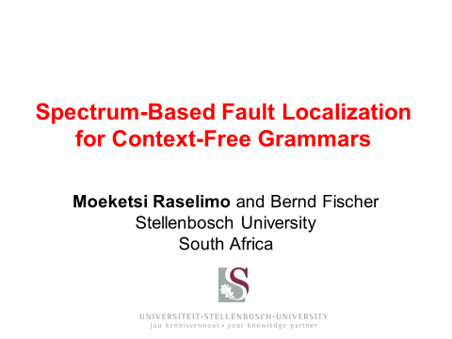
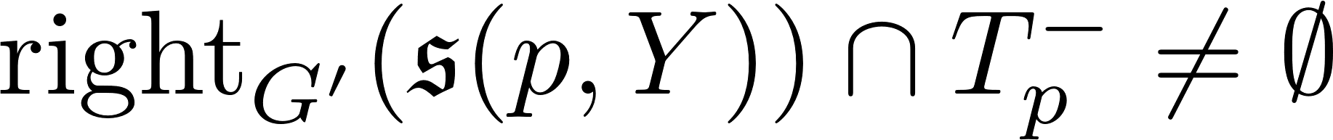
Passive repair repairs against a fixed test suite.
IMPROVED!
patch preconditions
and bigram validation
. . .
item-level localization
patches as string edit operations
✗
✓
program a begin relax end
program a begin a ::= 0 end
...
program a begin a(0) end
program a begin a(0,0) end
...
program a begin a(0) end
program a begin a(0,0) end
program a begin relax end
program a begin a ::= 0 end
...
program a begin a(0) end
program a begin a(0,0) end
...
Error in line 1, column 19: Syntax error.
Found NUM(0), expected token classes are [].
5
Notes:
Automatic repair framework, has three main components, all designed to reduce search space for repairs
first, improved localization
second, limit patches to string edit operations (on rules interpreted as strings over grammar symbols)
third, explicit pre- and postconditions on patches

Slide 11
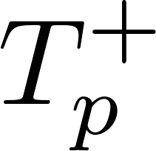
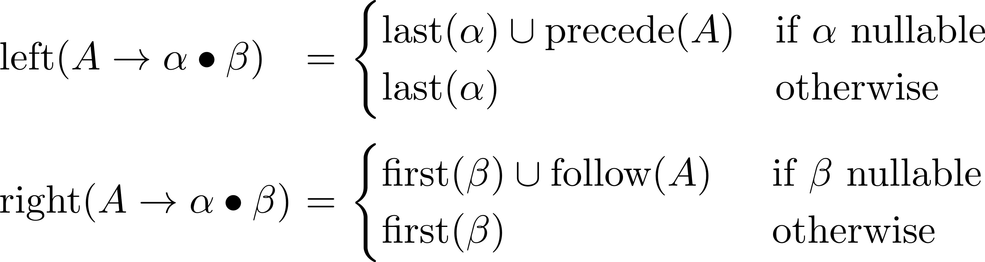
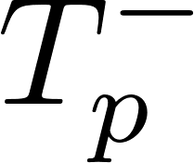
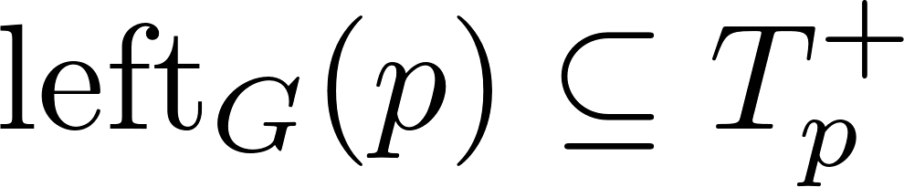
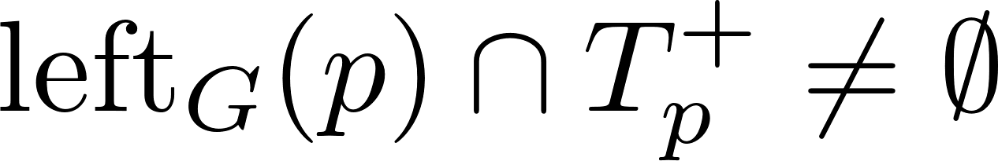

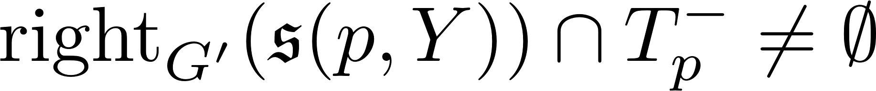
Grammar patches via symbol string edit operations
apply string edit operations 𝔢 at designated position of suspicious items
collect lexical information around parse error locations (per item)
… use it to eliminate candidate items that do not directly reflect error location
check (or weak form: )
… use it to eliminate candidate edits that cannot improve the grammar
allow only substitutions such that
  can also use
good tokens
program a begin a(• 0) end
program a begin a(• 0,0) end
bad tokens
6
Notes:
use lexical context to reduce search space
per time == look at all failing test cases where the rule is used
num is not the only possible substitution, anything with num in first set works

Slide 12
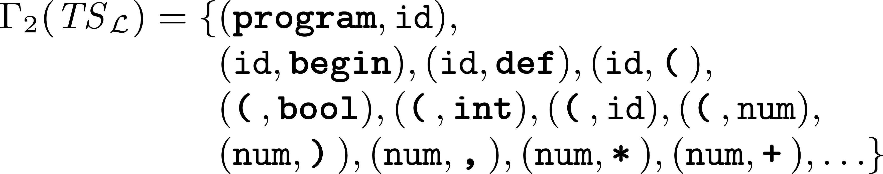
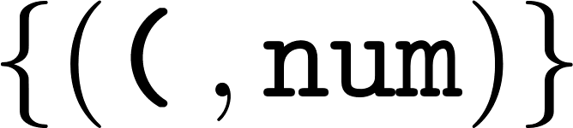
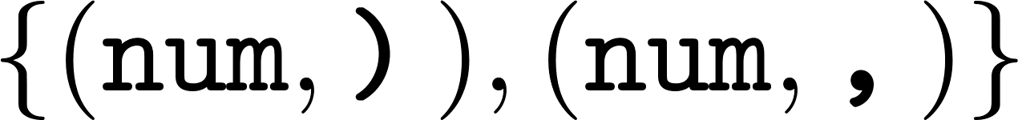
Grammar patches via symbol string edit operations (cont.)
apply string edit operations 𝔢 at designated position of suspicious items
collect lexical information around parse error locations (per item)
… use it to eliminate candidate items that do not directly reflect error location
… use it to eliminate candidate edits that cannot not improve the grammar
collect lexical information from valid tests (bigrams)
… use it to eliminate patches (patch validation)
program a begin relax end
program a
def a(int a) begin relax end
begin relax end
program a begin a(0) end
...
✓
7
Notes:
now try to exploit information from test suite
for substitution check that substituted symbol doesn’t introduce “poisoned pairs”, also next symbol (ie check left and right of substituted symbol)

Slide 13
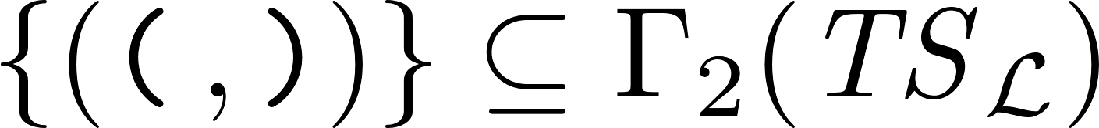
Grammar patches via symbol string edit operations (cont.)
apply string edit operations 𝔢 at designated position of suspicious items
collect lexical information around parse error locations (per item)
… use it to eliminate candidate items that do not directly reflect error location
check
… use it to eliminate candidate edits that cannot not improve the grammar
check
collect lexical information from valid tests (bigrams)
… use it to eliminate patches (patch validation)
check
✓
✓
✓
similarly: insertion, transposition, listification
8
Notes:
different edit operation (deletion), same schema, different conditions
listification introduces repetitive structures

Slide 14
Passive repair examples
9

Slide 15
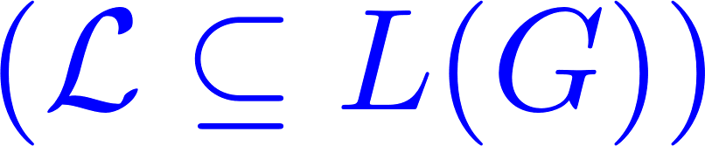
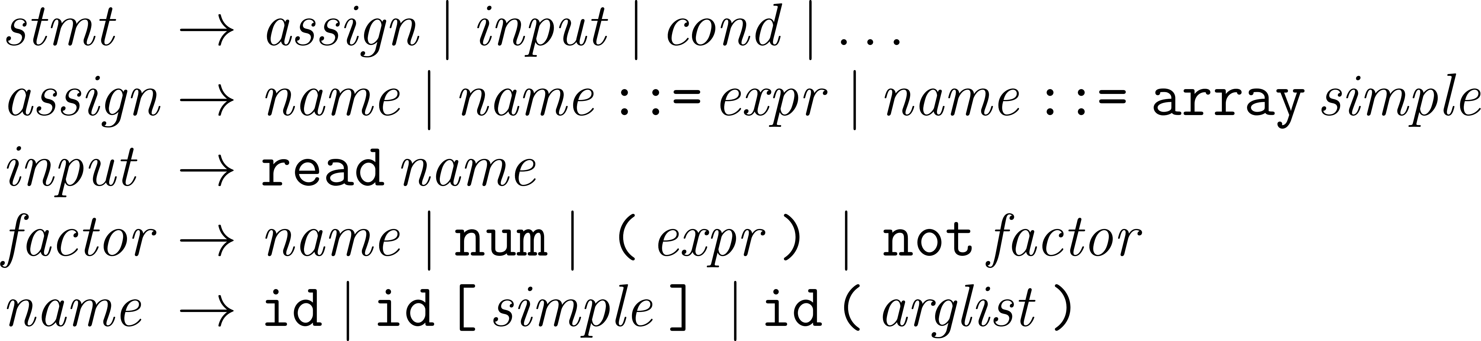
Fixing over-generalizing grammar bugs
should reject
✗
program a begin a end // function call without argument list
program a begin a[0] end // array indexing expression as statement
program a begin a(0) ::= 0 end // function calls as lvals in assignments...
program a begin a(0) ::= array 0 end // ... array initialization
program a begin read a(0) end // ... input statements
program a begin a[0] ::= array 0 end // higher-dimensional arrays
10

Slide 16
Fixing over-generalizing grammar bugs
should reject
✗
program a begin a end // function call without argument list
program a begin a[0] end // array indexing expression as statement
program a begin a(0) ::= 0 end // function calls as lvals in assignments...
program a begin a(0) ::= array 0 end // ... array initialization
program a begin read a(0) end // ... input statements
program a begin a[0] ::= array 0 end // higher-dimensional arrays
10
Notes:
changes into stmt because of suspiciousness scores
factor not eliminated because no improvement

Slide 17
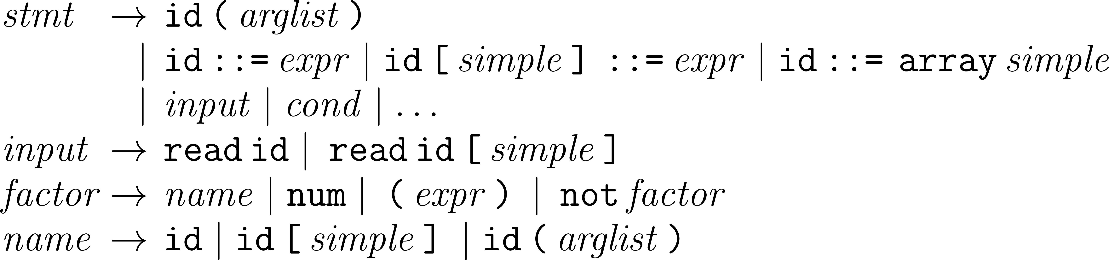
Fixing over-generalizing grammar bugs
gfixr repair
11
Notes:
changes into stmt because of suspiciousness scores
factor not eliminated because no improvement

Slide 18
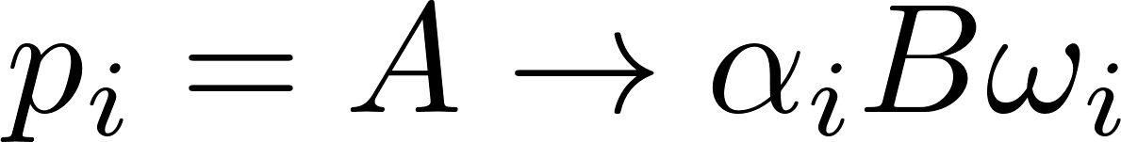
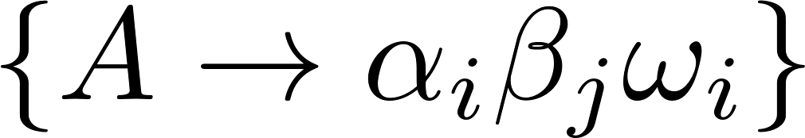


Language Tightening Transformations
reduction item, used in passing and failing tests, failures are counterexamples
non-terminal splitting: fold all rhs of a non-terminal into all of its occurrences
if
replace all by for all
rule deletion: remove error productions
if
remove
token splitting, token introduction
delisting: elimination of immediate left / right recursion
list restructuring: shift epsilon-productions to “shield” separators
Problem: tightening requires counterexamples
12
Notes:
token splitting is like non-terminal splitting, but on a token; token introduction lifts a lexeme of one token to a separate new token (id -> keyword)

Slide 19
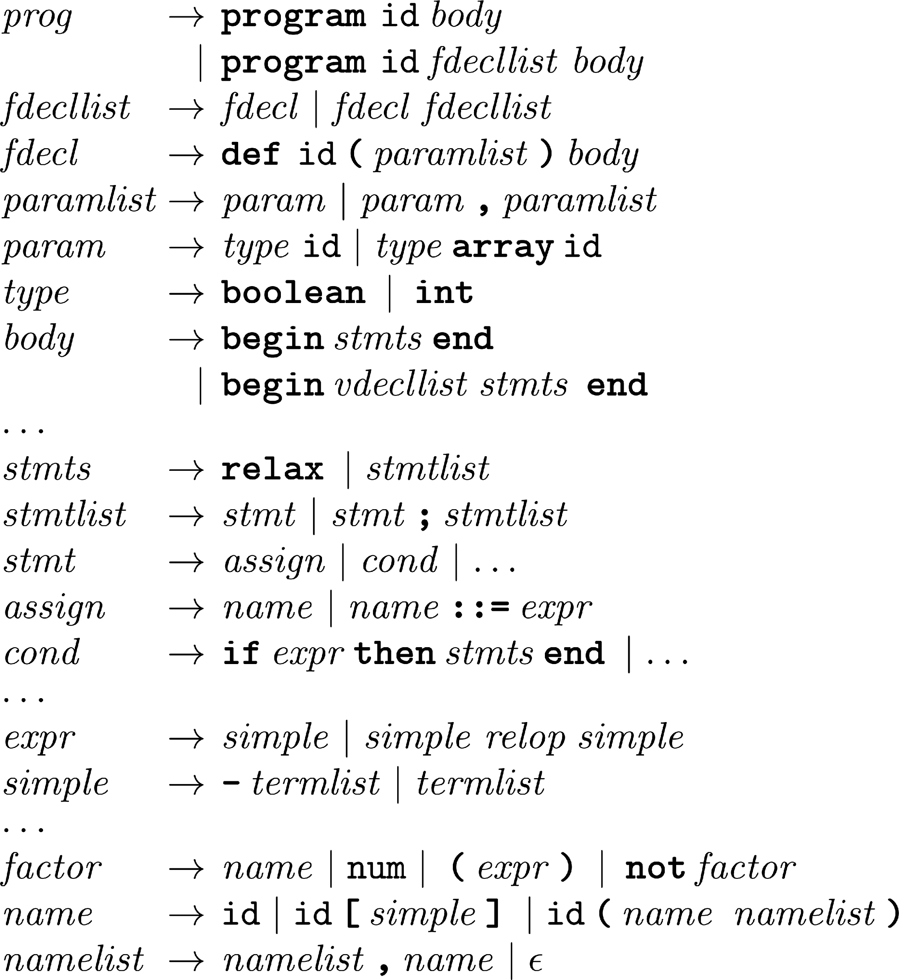



Active repair generates the test suites used for repair.
sentence generation
g
use target language parser to determine expected outcome
program a begin relax end
program a begin a ::= 0 end
...
program a begin a(0) end
program a begin a(0,0) end
...
program a begin relax end
program a begin a ::= 0 end
. . .
program a begin a(0) end
program a begin a(0,0) end
...
program a begin a(id) end
. . .
program a begin a(id, id) end
. . .
program a begin a((a)) end
program a begin a(1+a, a) end
. . .
program a begin a(a()) end
. . .
program a begin relax end
program a begin a ::= 0 end
...
program a begin a(0) end
program a begin a(0,0) end
...
program a begin a(id) end
. . .
program a begin a(id, id) end
. . .
✗
program a begin a(0) end
program a begin a(id,0) end
✗
initial test suite (optional)
priority queue
13

Slide 20
Active repair generates the test suites used for repair.
g
program a begin relax end
program a begin a ::= 0 end
. . .
program a begin a(0) end
program a begin a(0,0) end
...
program a begin a(id) end
. . .
program a begin a(id, id) end
. . .
program a begin a((a)) end
program a begin a(1+a, a) end
. . .
program a begin a(a()) end
. . .
program a begin a(a, a+a) end
. . .
program a begin a(1, (a)) end
. . .
program a begin relax end
program a begin a ::= 0 end
. . .
program a begin a(0) end
program a begin a(0,0) end
...
program a begin a(id) end
. . .
program a begin a(id, id) end
. . .
program a begin a((a)) end
program a begin a(1+a, a) end
. . .
program a begin a(a()) end
. . .
program a begin a(id,0) end
✓
priority queue
14

Slide 21
Active repair examples
15

Slide 22
Grammar Repair Evaluation
Goals:
evaluate effectiveness
compare passive and active repair flavours
Evaluation subjects:
33 medium-sized student grammars containing real and multiple faults
Test suites:
cdrc test suite generated from target grammar as specification
cdrc test suite generated from each candidate patch in case of active repair
validation against much stronger test suites (including random and negative)
16

Slide 23
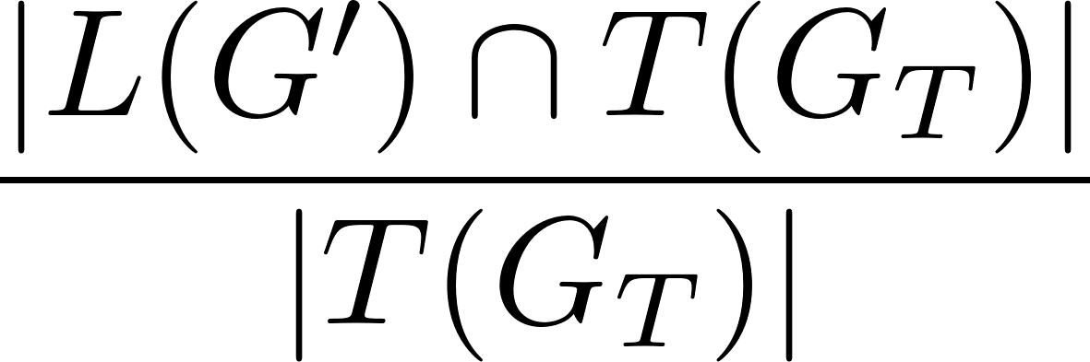
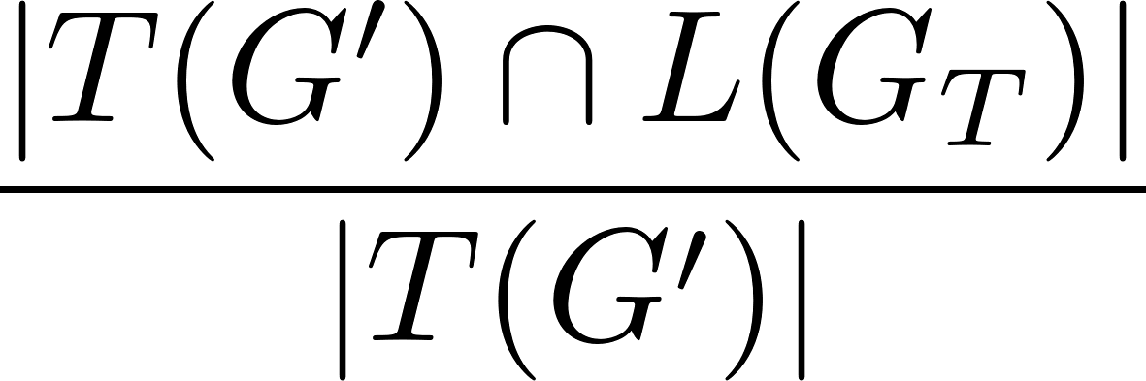
Grammar Repair Evaluation
Evaluation metrics:
recall: do the patches generalize to unseen tests?
precision: how closely do the patches approximate the target?
F1 score: combined measure of the quality
generate parser
generate tests
prog → program id = block .
block → { (decl ;)∗ (stmt ;)∗ }
decl → var id : type
type → bool | int
stmt → sleep
| if expr then stmt (else stmt)?
| while expr do block
| id = expr | block
expr → expr = expr | expr + expr
| (expr ) | id | num
recall
prog → program id = block .
block → { (decl ;)∗ (stmt ;)∗ }
decl → var id : type
type → bool | int
stmt → sleep
| if expr then stmt (else stmt)?
| while expr do stmt
| id = expr | block
expr → expr = expr | expr + expr
| (expr ) | id | num
precision
generate tests
generate parser
patched grammar G’
target grammar G_{T}
17
Notes:
definitions approximate, hold only if only positive tests are generated (need to do pairwise intersection with negs)
F1 = 2*prec*rec / (prec+rec)

Slide 24
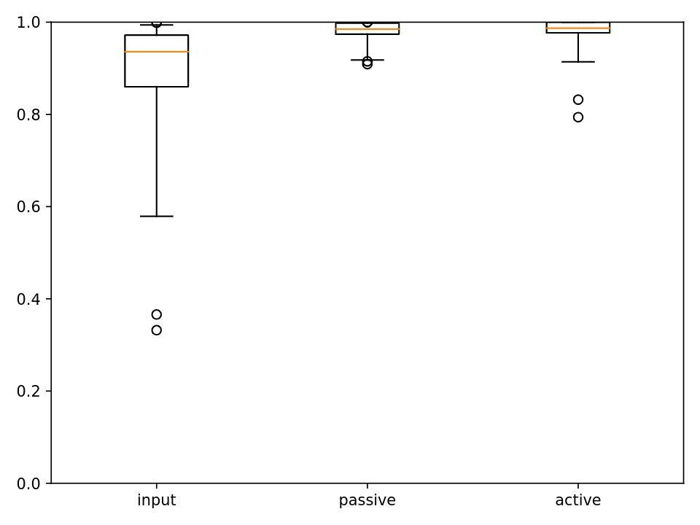
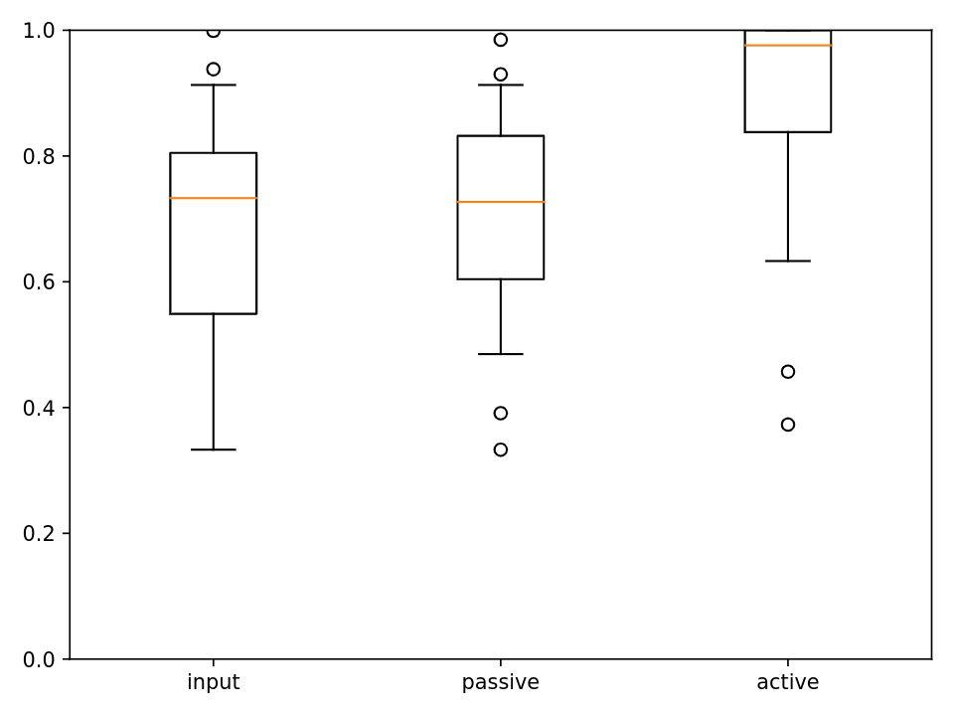
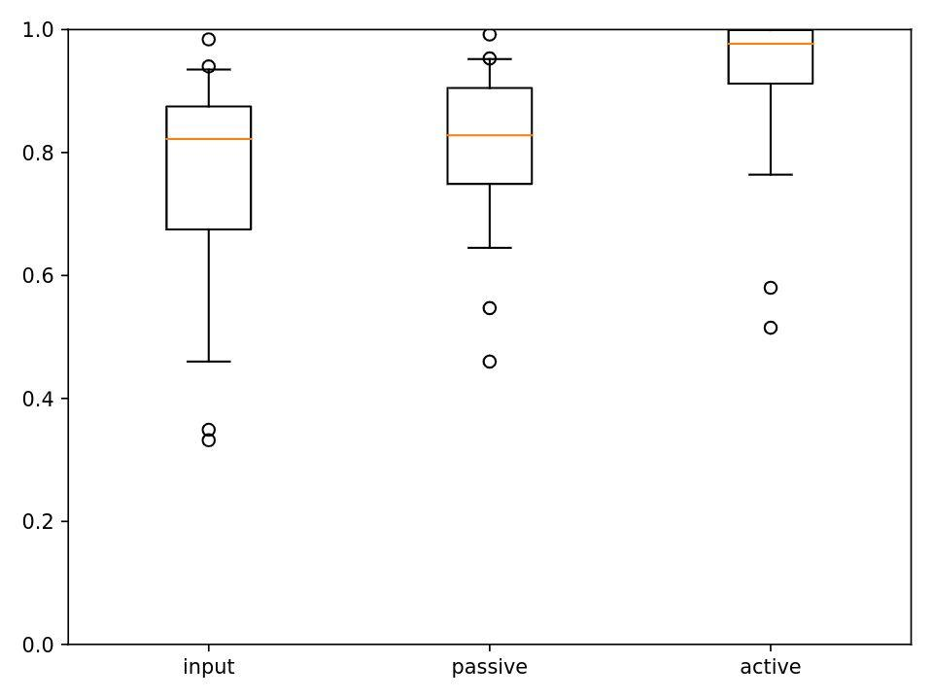
Passive repair is effective.
25 full repairs; 4 partial repairs;
4 grammars unrepairable with input test suite (no failing tests)
fixes generalize to new unseen tests (improvements in recall)
minor improvements in precision; sometimes drops
repair times typically ~ 5-15 minutes
recall
precision
F1 score
no overfitting
but overgeneralization
18

Slide 25
Detailed Results: Passive Repair
accuracy drops
repair failures
most patches
slow repairs
19

Slide 26
Active repair is slower but much better!
27 full repairs; 6 partial repairs
repair times typically ~ 15-60 minutes
counterexamples give tighter patches
mostly high F1 scores
many perfect patches (100% F1)
recall
precision
F1 score
20

Slide 27
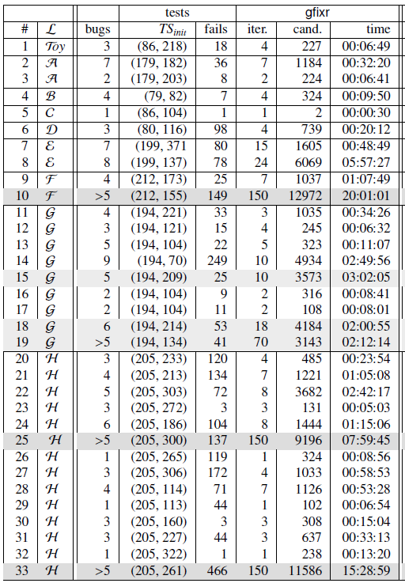
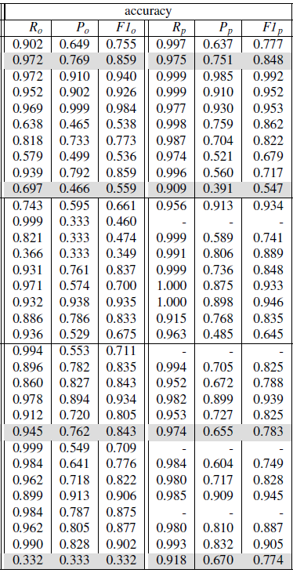
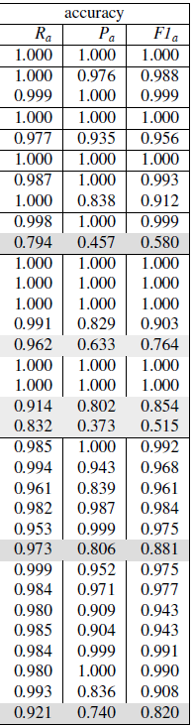
Detailed Results: Active Repair
initial + active tests
perfect repairs
s
repair failures
partial repairs
accuracy drops
slow repairs
21

Slide 28
Automatic grammar repair is possible.
relies on precise item-level fault localization
use small-scale transformations with explicit pre- and post-conditions as patches
implemented and evaluated two grammar repair approaches
successfully repaired student grammars against test suites
Future Work
migrate to modern compiler-compiler tools
investigate multiple-bugs-at-a-time approach
generate-localize-repair approach for grammar mining
22

